Slide 1
Car Rental system

Slide 2
Project Idea
An application to provide a car rental service, which can be rented for a day or for several monthsTHIS APP FORFor customers who want to rent a carFor employees of a car rental company.

Slide 3
Used Data Structure :
01
02
03
1 Array List
Class Employees
2 Linked List
Clss Cars, Class CustomerQueueList
1 Queue
Class CustomerQueueList

Slide 4
Array List
01
Empoloyees
Used algorithms:
1- Insertion sort Algrothim to sort employees first namesO(n^2)
2- merge sort algorithm to sort employees first namesO(nlogn)

Slide 5
LinkedList
02
Clss Cars
Used algorithms:
1- Insertion sort Algrothim to sort Cars Car make O(n^2)
2- merge sort algorithm to sort Cars Car make O(nlogn)
3- leaner search algorithm to search for car using registration number O(n)
4- linear recursion sum To calculate the expected daily, monthly and yearly profit of the company
Customer
Used To store customer rentals

Slide 6
Queue
03
CustomerQueueList
algorithms:
1- Insertion sort Algrothim to sort cutomer by name O(n^2)
2- Recursion Algrothimto calculate the total rental price Cars
3- leaner search algorithm to search for customer O(n)

Slide 7
OUTPUT OF LOG IN AS EMPLOYEE

Slide 8
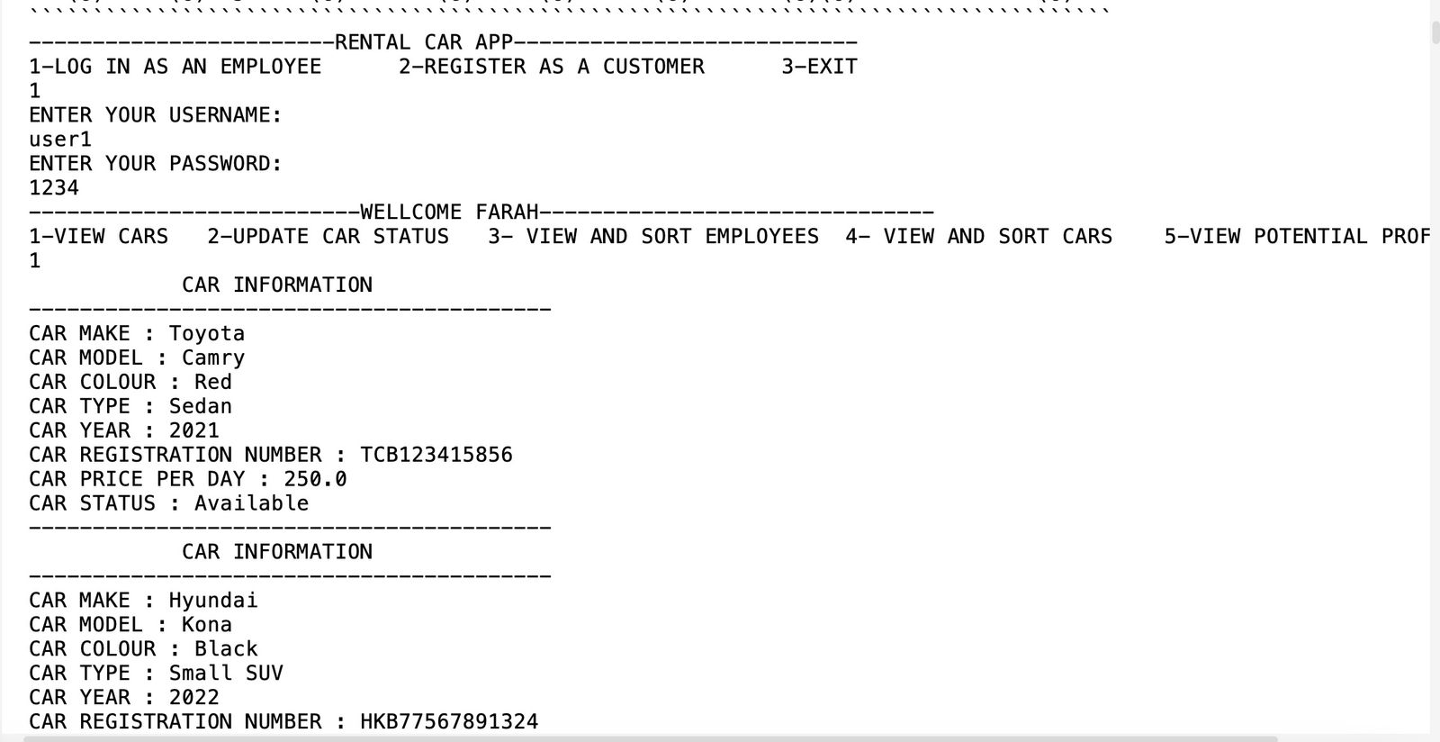
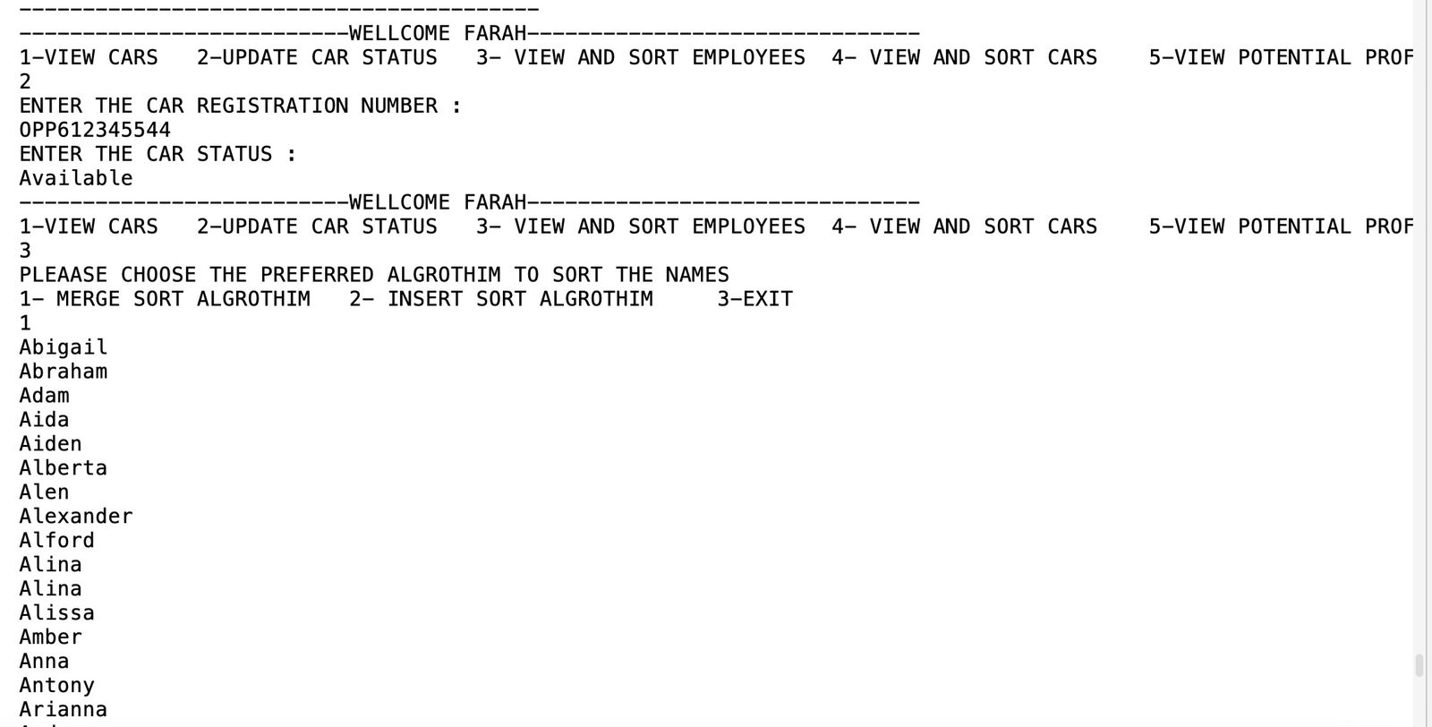

Slide 9
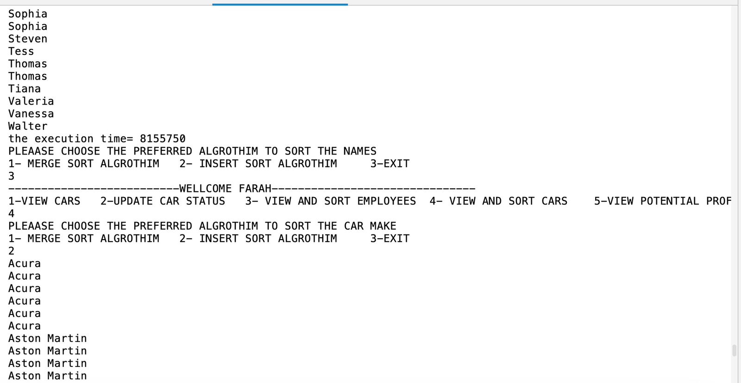
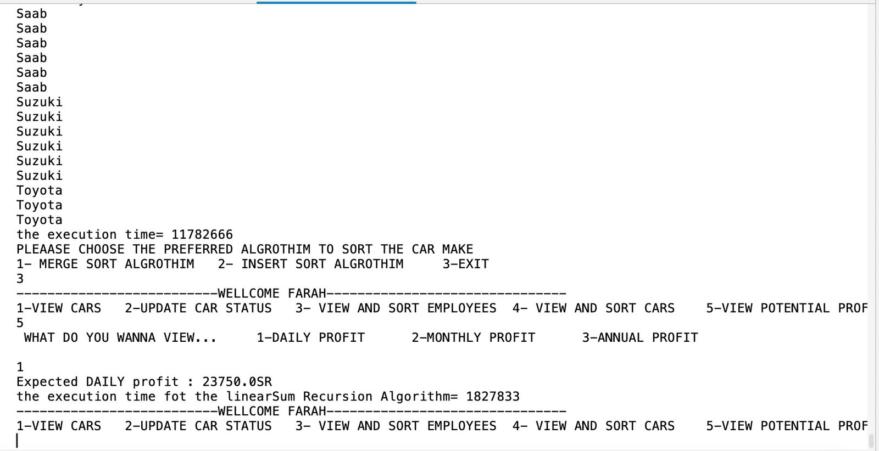

Slide 10
OUTPUT OF REGISTER AS A CUSTOMER

Slide 11
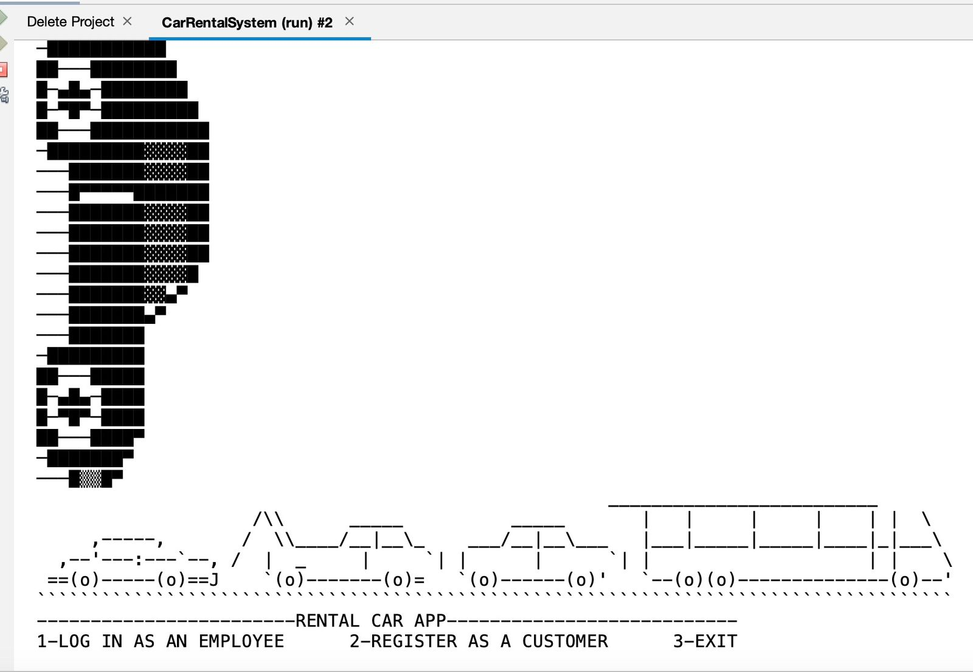
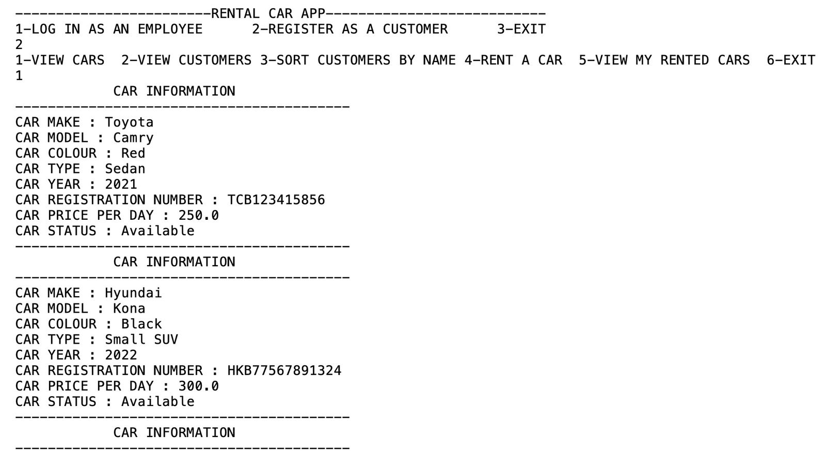


Slide 12
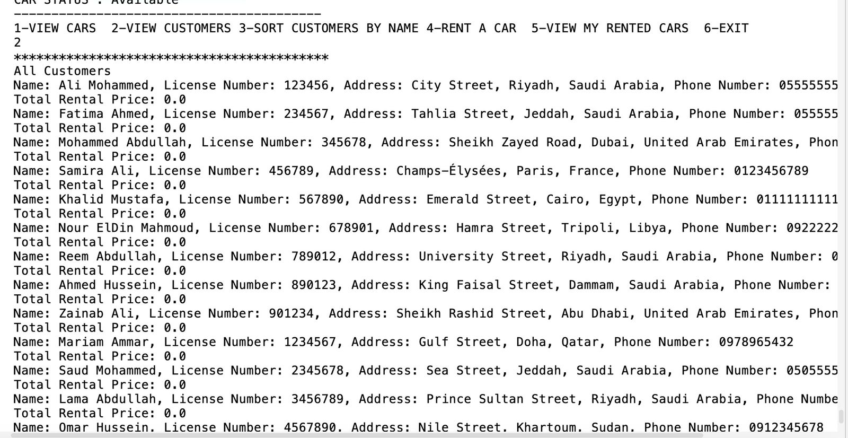
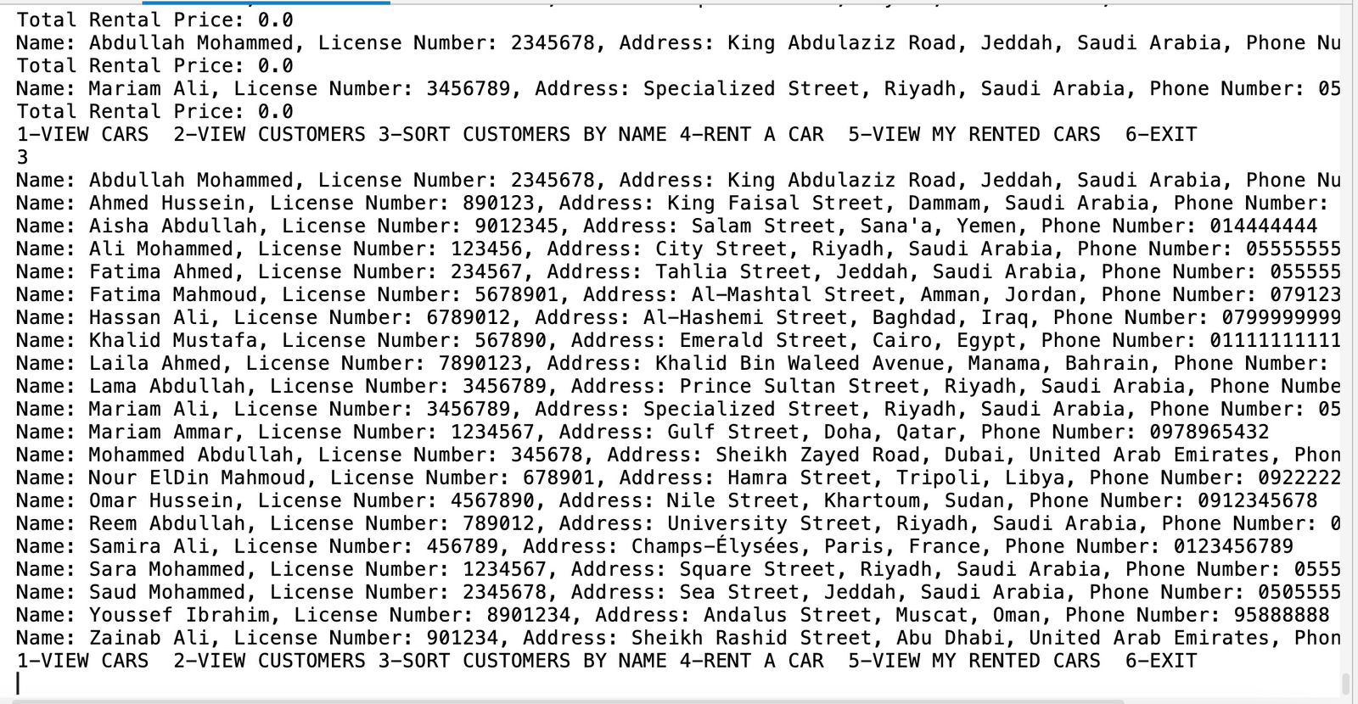



Slide 13
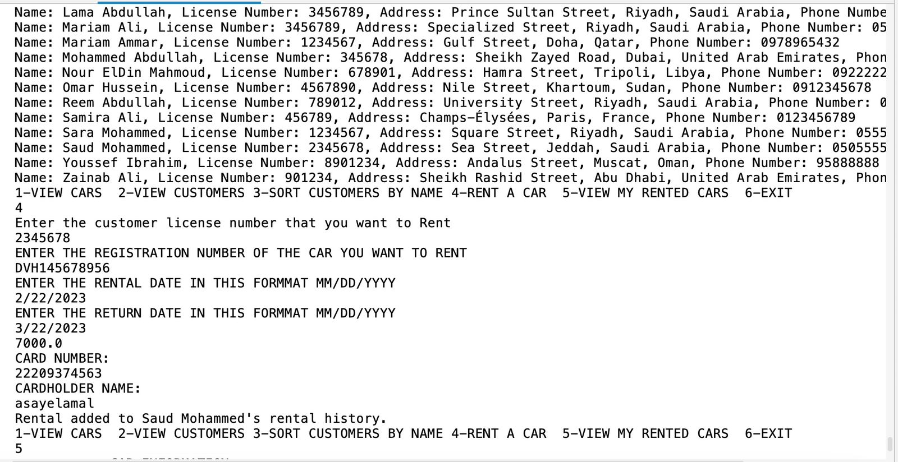
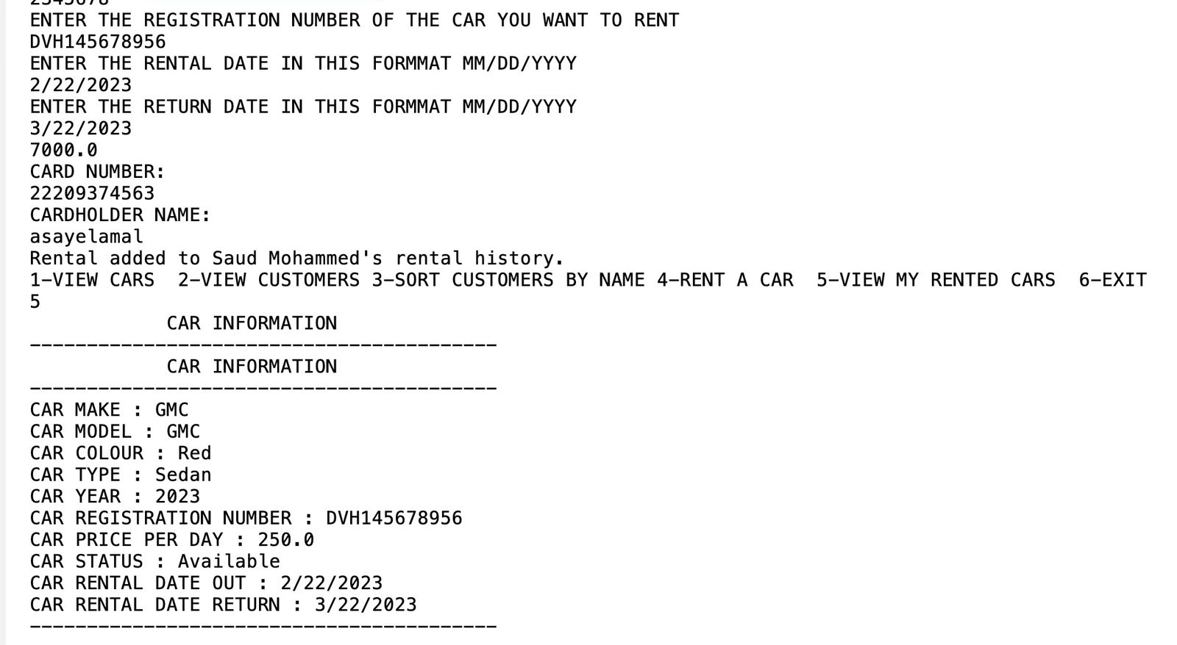





Slide 14
BIG O For some method

Slide 15
public double calculateTotalRentalPrice(Customer customer) { double total = 0.0; for (Rental rental : customer.getRentals()) { total += rental.getTotalPrice(); } return total; }
The big O notation for this code is O(n), where n is the number of rentals in the customer's rental list. The time complexity increases linearly with the number of rentals, so it has a linear time complexity.

Slide 16
public void insertionSort( ArrayList < Employees> a ){ int i, j, k; Employees temp; for (i = 1; i < a.size(); i++){ temp = a.get(i); for (j = 0; j < i; j++) { if (a.get(i).compareTo(temp) > a.get(i).compareTo(a.get(j))) { break; } } for (k = i; k > j; k--) { a.set(k, a.get(k-1)); } a.set(j,temp); } }
The worst-case time complexity for this insertion sort algorithm is O(n^2), where n is the size of the input array. The total number of comparisons and swaps is roughly (1/2)n^2, which gives us a quadratic time complexity.

Slide 17
comparison
We use this method :
long startTime = System.currentTimeMillis();
long endTime =System.currentTimeMillis();
long elapsed = end Time - startTime;
To compare between insert sort algrothim and merge sort algrothem on linked list and array list

Slide 18
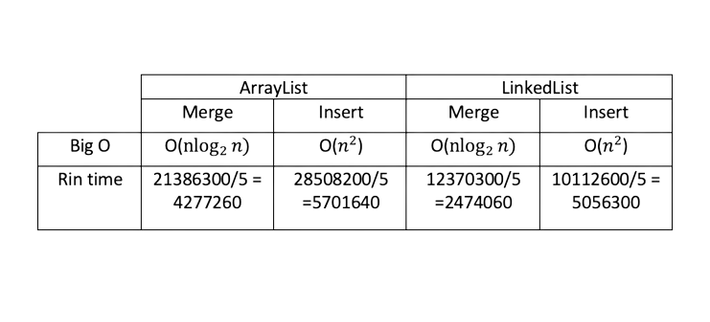
comparison
Based on the schedule:
1-merge sort algorithm is better than insert sort algorithm.
2- linked list is better than array list in sorting.

Slide 19
LinearSum

Slide 20


Input: Integer n such that 0 ≤ n ≤ |A|.
Output: total sum of of all the cars price per day.
base case :Is when n == 0, that means we reached the end of the array.
recursive case : summing the price of the next car In the index with the price of the car in the current index.
public double linearSumRecursion(int n) {
if ( n == 1 ) {
//base case
return cars.get(0).getCarPricePerDay();}
//recursive case
else if ( n > 0 ) {
return linearSumRecursion(n - 1) + cars.get(n -1).getCarPricePerDay();
} else {
return -1;
} //else
}

Slide 21

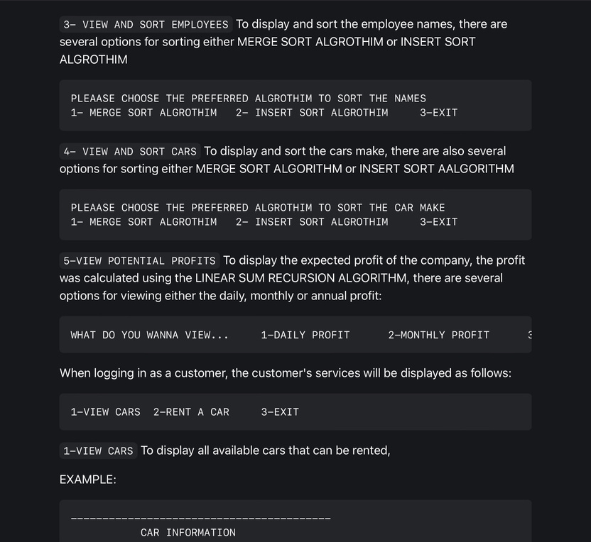
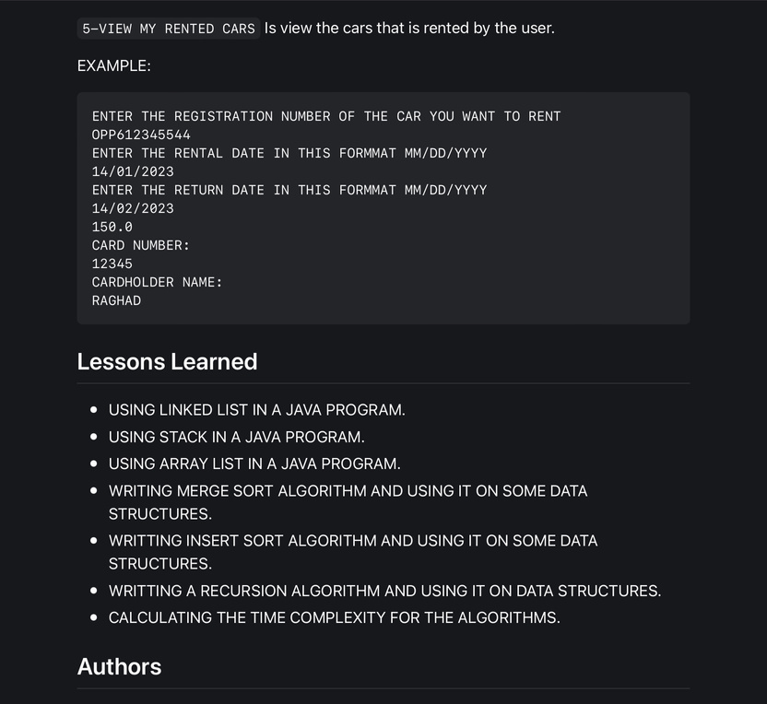
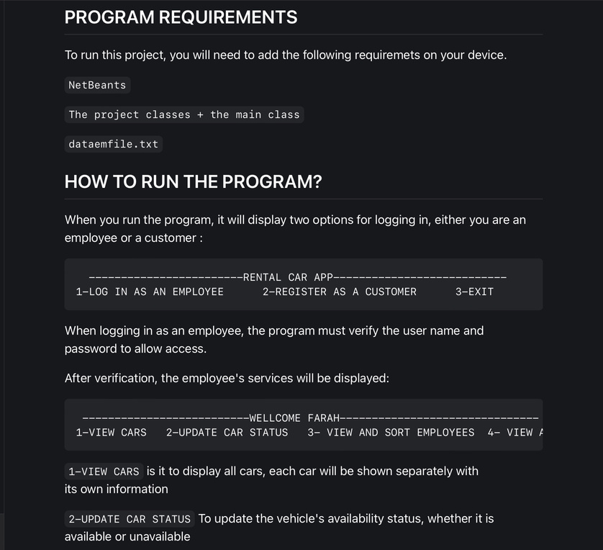
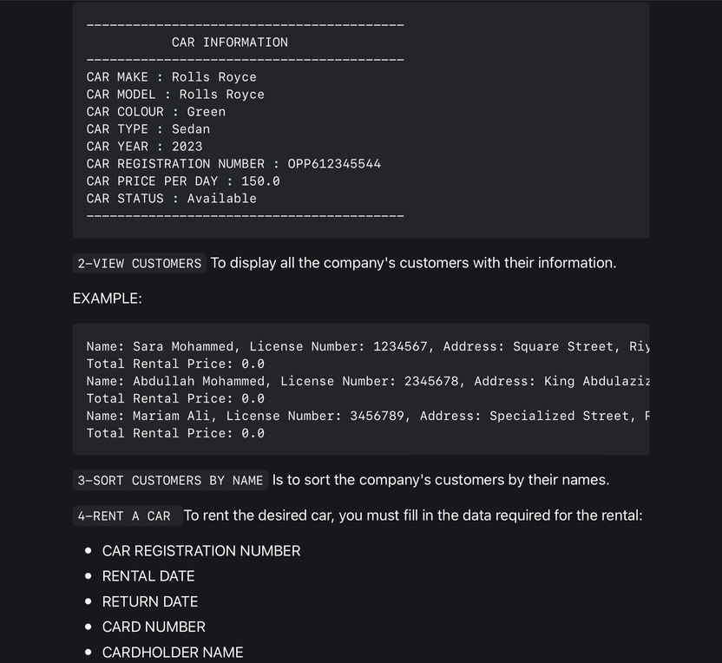
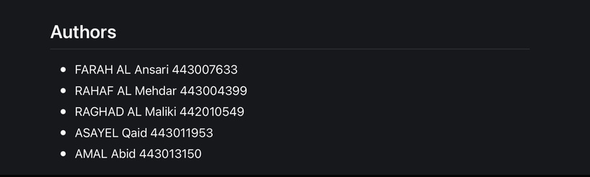
readme.md

